Slide 1
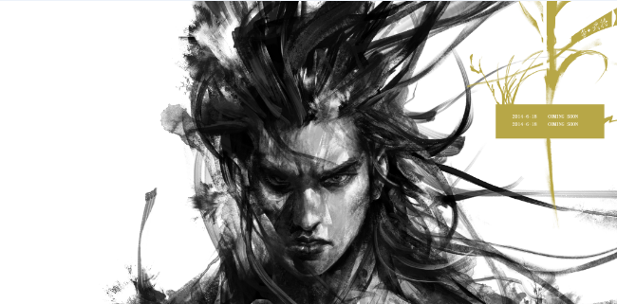
《Iron Knight》

Slide 2
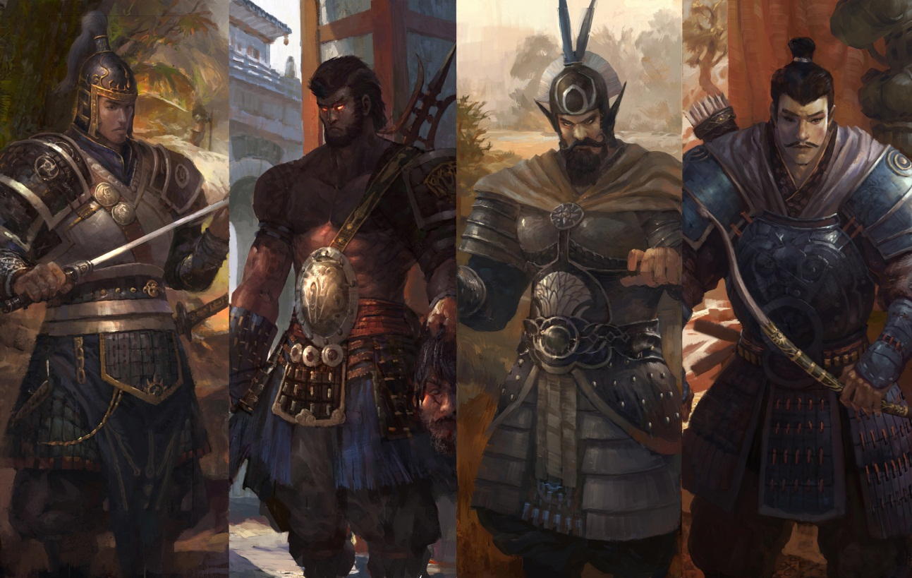
Product name: Iron Knightn
Game style: Action
Art style: 3D realistic
Project background: Product is now in development process, hasn’t been tested.
<Iron Knight> is an important creative 3D action online game developed by North Lights Game Studio under Tencent Game in 2013. This game restores the famous battles in Chinese history. Players can play different corps using rich cold weapons to ride, shoot, stab or hack. Its abundant combat modes, diverse collocation of corps and military commanders, real battlefield environment and grand battle scale with hundreds of people will bring different experience of real war. In addition, the derivative product and social play of this game such as card collection, home and military construction build social play will make the entire war experience more fullness.

Slide 3
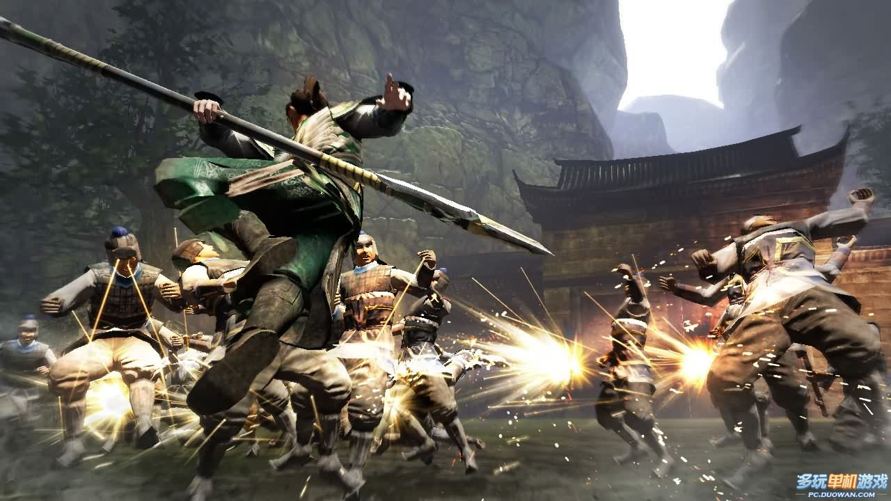
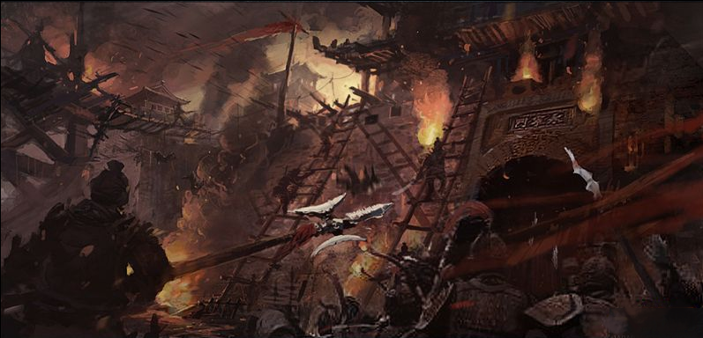
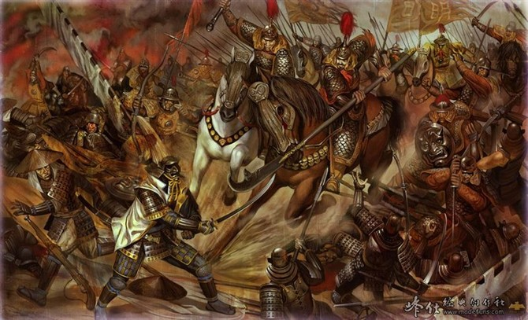
The bloody battle to restore the nature of arm
The abundant modes to restore the original battle
The famous battle to reflect the history

Slide 4
Examine the product
Product analysis
Characteristics play:
Game theme:
Game style:
Art style:
The backside of the product:
Sales information:
Cold weapons strightforward fight
Restore the famous battles and battle commanders in Chinese history
3D Realistic
Halest, Straightforward
/
？
Real arm experiences
豪爽
战斗
真实
战役
硬朗的风格

Slide 5
Examine the product
Product analysis
I don't have their guns, I have no assists and aid, I only have a pair of fearless body and mind, the battle is to witness my strength!
Characteristics play:
Game theme:
Game style:
Art style:
The backside of the product:
Sales information:

Slide 6
Product position
The first powerful war online game in Global
Strong, strength and bravery combine a hero
Battle field is the best place to test strength
This is a hard battle field, strength makes a here.
--Iron, strength and power one will win!
This is a field to test a man’s strength
--There will be a lot of opponents, if you are a man you must try!

Slide 7
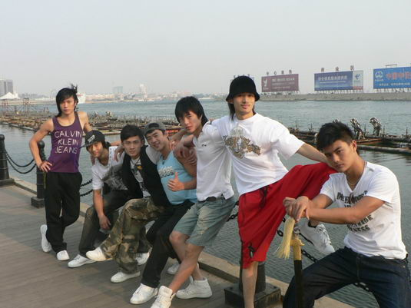
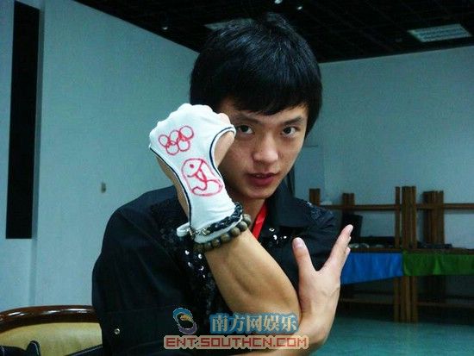
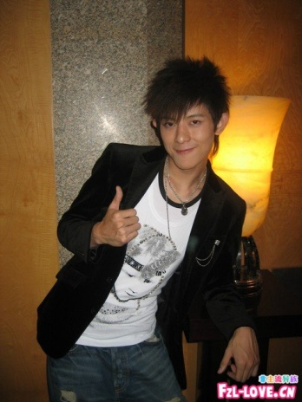
Our costumers？
The most valuable customers：
- Age: 17-24，slightly younger than the average age of online game players；
- Priority gender: Male
- They are already online game players, their preference is the online game played mainly with FPS skills；
- They watch movies such as “heroes”, they admire the still-willed hero with courage and spirits.

Slide 8
Their inner conflicts:
They desire and reality
They are full of blood and eager to show their manliness. Like the fearless hero in the movie, they try hard to prove themselves.
But in reality they had to be surrounded by parents, morality and ordinary social life, they don’t have time and courage to prove themselves.

Slide 9
Their inner conflicts:
Show the strengths VS can’t show
Our costumers，have courage and achievement muscle in their body
They are eager to be couraged：This man is strong, brave and fearless!

Slide 10
They love to be approved!
The first powerful war online game in Global
Should be where the same strong men gather，
Should be where the strong man try and fight！
Here is the place where you show yourslef！

Slide 11
Product position
War with real power
Show the strength VS can’t show yoursleves
Fearless!
《Iron Knight》 encourage the strong men to pursue themselves in the war! If you have strengths, don’t miss this war, Iron Knight！

Slide 12
Key words that show the attitude of《Iron Knight》？

Slide 13
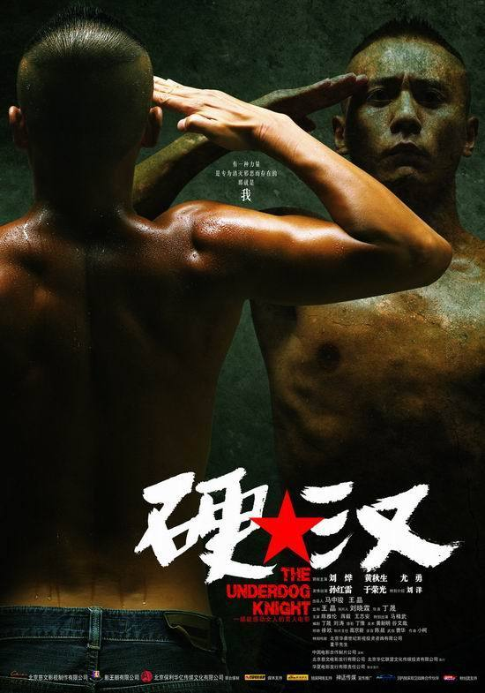
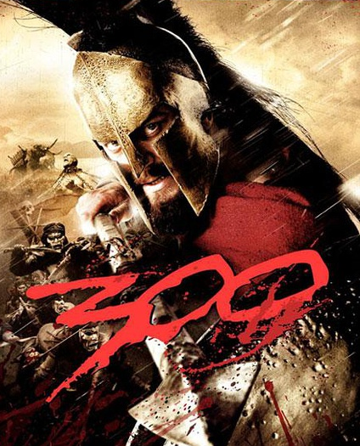
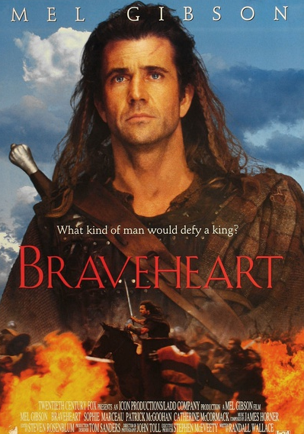
Attitude definiton
Hard
Dare to think and dare to do it!
Display
Dare to show a man’s character inside
Fearless
I want to fight to the end even I lose!
Bloody
To fight is in my DNA!
Strength
I don’t have their guns and any aids but I have enough power!

Slide 14
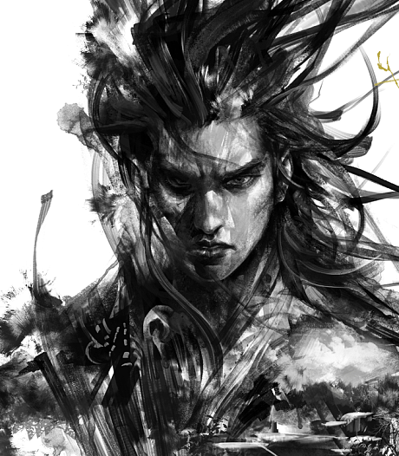
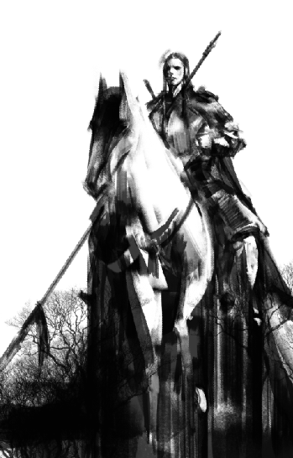
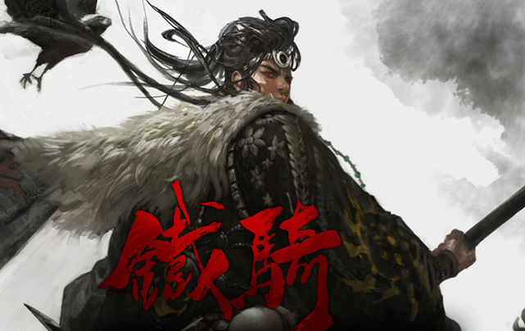
Original picture style

Slide 15
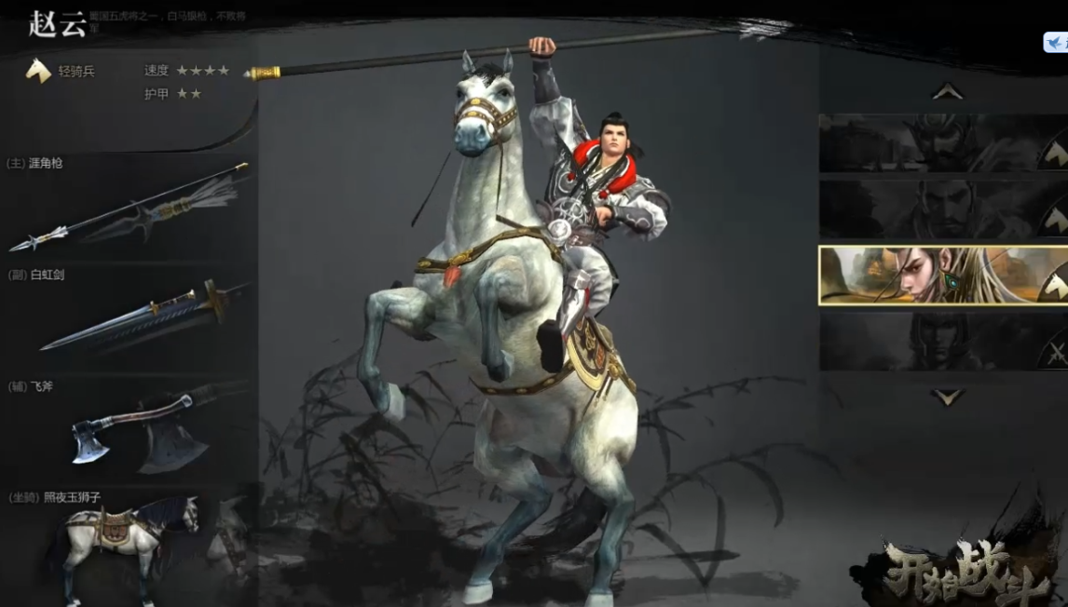
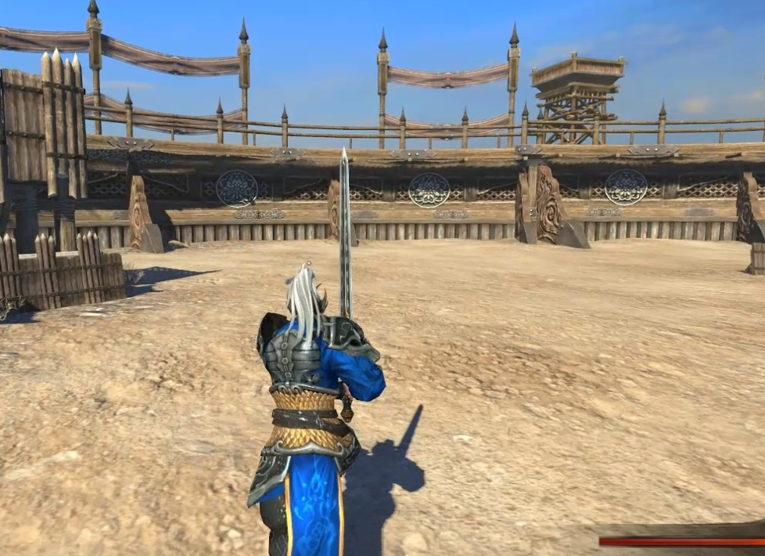
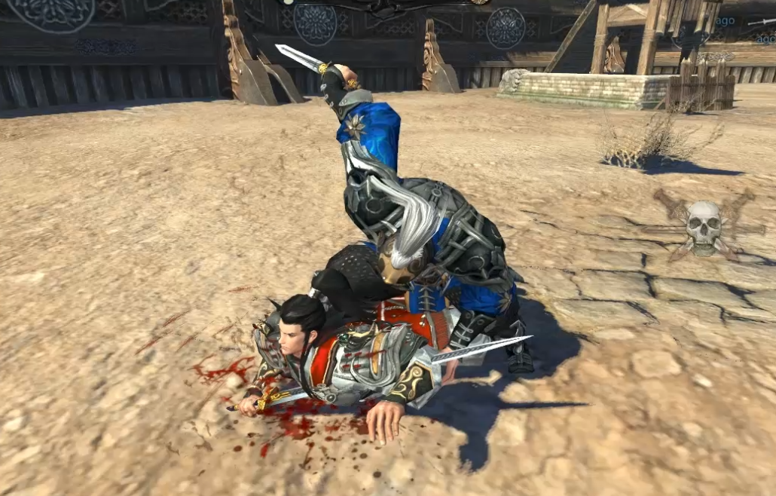
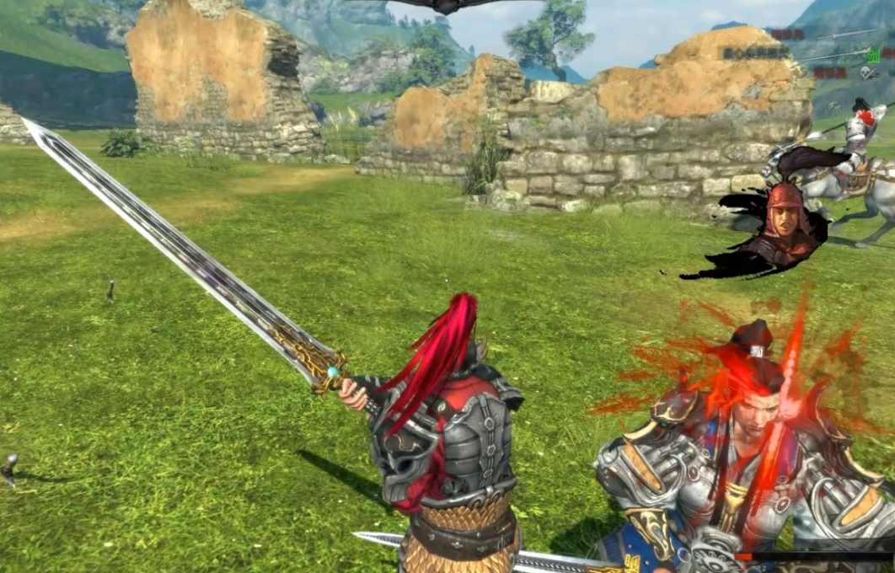
Game screenhots:

